Slide 1





INSURANCE CLAIM PREDICTION
Student: Aytan Mardaliyeva
Group: RDS104
PASHA INSURANCE

Slide 2







AGENDA:
STEP 01
Overview of Company
STEP 02
Problem Description
Problems in the company
STEP 03
STEP 04
Business Objectives of the Project
STEP 05
Data and insights
STEP 06
Results

Slide 3

ABOUT COMPANY:
Established in 2006, PASHA Insurance is one of the prominent leaders in Azerbaijan’s non-life insurance services market. The company currently has a statutory capital of 50 million manat and provides services in 36 types of voluntary and compulsory insurance to nearly 700,000 corporate and individual clients.

Slide 4






Fraud Detection
Data
Claims Prediction
Science
Applications in insurance industry
CLT Prediction
Recommendation systems
Personalized Services
60% of insurers say insights from predictive analytics have increased sales and profilability

Slide 5

WHAT IS CAR INSURANCE CLAİM PREDİCTİON?
Car insurance claim prediction refers to the use of data analysis and machine learning techniques to forecast various aspects related to insurance claims. This process aims to anticipate future claims based on historical data and other relevant factors.

Slide 6

What Factors Affect an Effective Insurance Company?
Credibility
Product quality
Financial condition
Premium competitiveness

Slide 7





Problems:
O4
Acquiring New Customers
O2
Pricing Problem
Competitive Analysis
Protecting Existing Customers
O1
O3
O1

Slide 8




Business Objectives of the Project :
O4
O2
Fraud Management
Management of premium pricing
Personalized Offers
Financial Planning
O1
O3
O1

Slide 9

What factors influence the risk of car insurance claims?
Driver Behavior
Vehicle Characteristics
Geographic Location
Demographic Factors
Policy Features
Insurance History

Slide 10

Features Used in the Project:
Age
Speeding violations
Education level
Driving Experience
Gender
Family members
Income
Vehicle type
Martial Status
Location
Credit Score

Slide 11
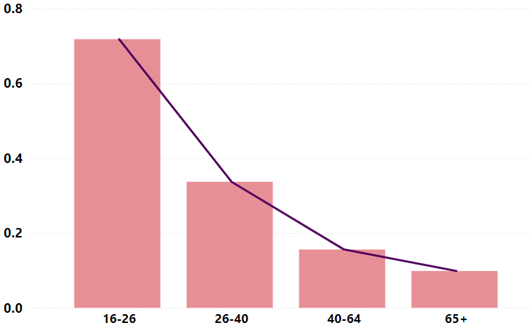
Average claim risk by age category:

Slide 12
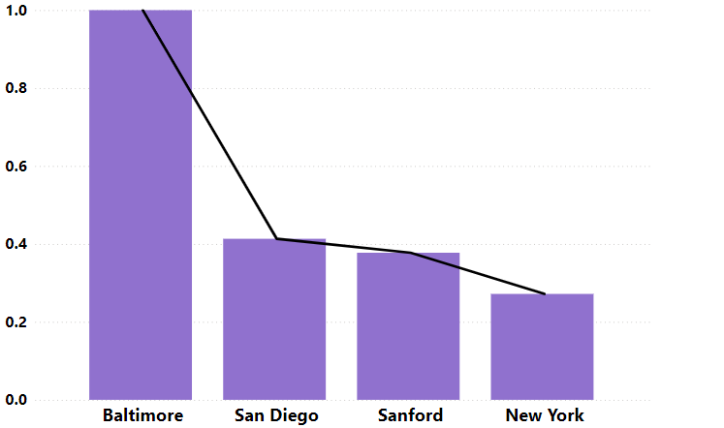
Average claim risk by location:

Slide 13
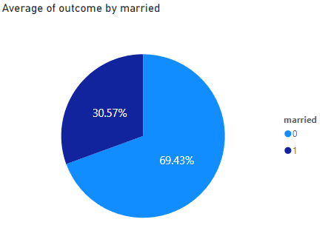
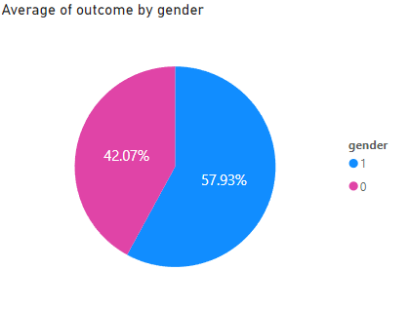
Average claim risk for:
Martial Status:
Gender:

Slide 14
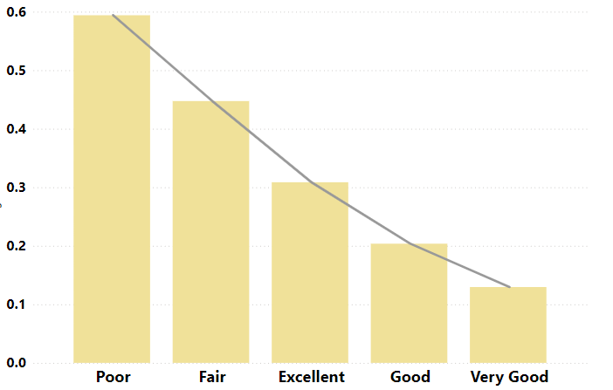
Average claim risk by credit score:

Slide 15
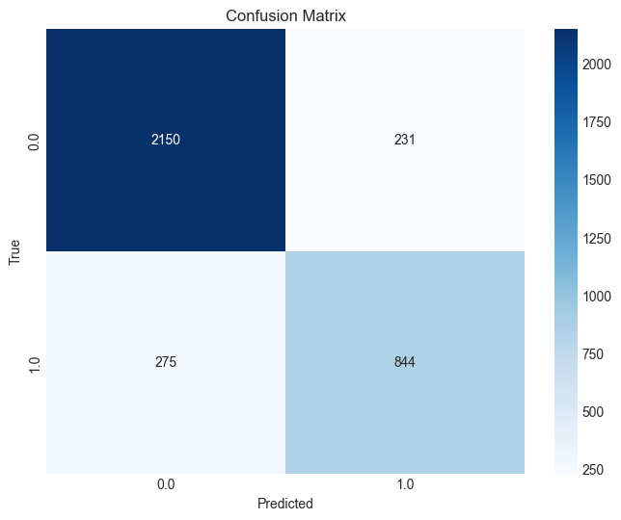
Results:
Accuracy: 0.85
F1 Score: 0.76
Precision: 0.77
Recall: 0.75

Slide 16


Thank you for your attention!
CONTACTS:
Aytan Mardaliyeva
aytenmerdeliyeva@gmail.com

